Slide 1
Fuzzy Logic

Slide 2
Fuzzy Logic tries to capture the human ability of reasoning with imprecise information
Models Human Reasoning
Works with imprecise statements such as:
In a process control situation, “If the temperature is moderate and the pressure is high, then turn the knob slightly right”
The rules have “Linguistic Variables”, typically adjectives qualified by adverbs (adverbs are hedges).

Slide 3
Underlying Theory: Theory of Fuzzy Sets
Intimate connection between logic and set theory.
Given any set ‘S’ and an element ‘e’, there is a very natural predicate, μ_{s}(e) called as the belongingness predicate.
The predicate is such that,
μ_{s}(e) = 1, iff e ∈ S
= 0, otherwise
For example, S = {1, 2, 3, 4}, μ_{s}(1) = 1 and μ_{s}(5) = 0
A predicate P(x) also defines a set naturally.
S = {x | P(x) is true}
For example, even(x) defines S = {x | x is even}

Slide 4
Fuzzy Set Theory (contd.)
Fuzzy set theory starts by questioning the fundamental assumptions of set theory viz., the belongingness predicate, μ, value is 0 or 1.
Instead in Fuzzy theory it is assumed that,
μ_{s}(e) = [0, 1]
Fuzzy set theory is a generalization of classical set theory also called Crisp Set Theory.
In real life belongingness is a fuzzy concept.
Example: Let, T = set of “tall” people
μ_{T} (Ram) = 1.0
μ_{T} (Shyam) = 0.2
Shyam belongs to T with degree 0.2.

Slide 5
Linguistic Variables
Fuzzy sets are named by Linguistic Variables (typically adjectives).
Underlying the LV is a numerical quantity
E.g. For ‘tall’ (LV), ‘height’ is numerical quantity.
Profile of a LV is the plot shown in the figure shown alongside.
μ_{tall}(h)
1
0.4
4.5
0
1 2 3 4 5 6
height h

Slide 6
Example Profiles
μ_{rich}(w)
μ_{poor}(w)
wealth w
wealth w

Slide 7
Example Profiles
μ_{A} (x)
μ_{A} (x)
x
x
Profile representing
moderate (e.g. moderately rich)
Profile representing
extreme

Slide 8
Concept of Hedge
Hedge is an intensifier
Example:
LV = tall, LV₁ = very tall, LV₂ = somewhat tall
‘very’ operation:
μ_{very tall}(x) = μ²_{tall}(x)
‘somewhat’ operation:
μ_{somewhat tall}(x) = √(μ_{tall}(x))
hedges allow us to fine-tune our linguistic variables, making fuzzy logic a more versatile tool for capturing the nuances of human expression and reasoning.
somewhat tall
tall
1
μ_{tall}(h)
very tall
0
h

Slide 9
Representation of Fuzzy sets
Let U = {x₁,x₂,…..,x_{n}}
|U| = n
The various sets composed of elements from U are presented as points on and inside the n-dimensional hypercube. The crisp sets are the corners of the hypercube.
μ_{A}(x₁)=0.3
μ_{A}(x₂)=0.4
(0,1)
(1,1)
x₂
(x₁,x₂)
U={x₁,x₂}
x₂
A(0.3,0.4)
(0,0)
(1,0)
_{Φ}
x₁
x₁
A fuzzy set A is represented by a point in the n-dimensional space as the point {μ_{A}(x₁), μ_{A}(x₂),……μ_{A}(x_{n})}

Slide 10
Degree of fuzziness
The centre of the hypercube is the “most fuzzy” set. Fuzziness decreases as one nears the corners
Measure of fuzziness
Called the entropy of a fuzzy set
Fuzzy set
Farthest corner
Entropy
Nearest corner

Slide 11
(0,1)
(1,1)
x₂
A
(0.5,0.5)
d(A, nearest)
(0,0)
(1,0)
x₁
d(A, farthest)

Slide 12
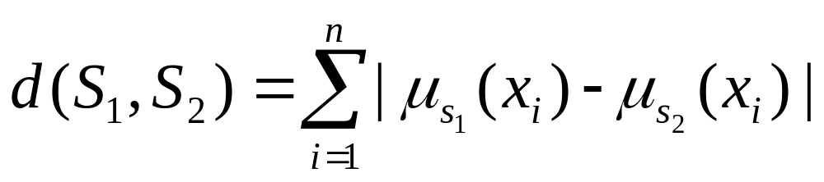
Definition
Distance between two fuzzy sets
L₁ - norm
Let C = fuzzy set represented by the centre point
d(c,nearest) = |0.5-1.0| + |0.5 – 0.0|
= 1
= d(C,farthest)
=> E(C) = 1

Slide 13
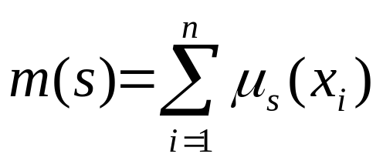
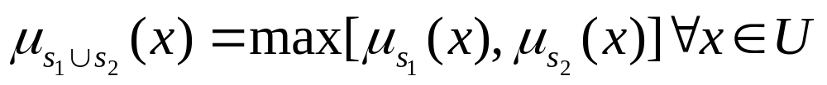
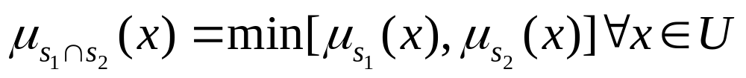
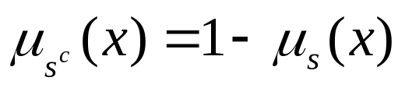
Definition
Cardinality of a fuzzy set
[generalization of cardinality of classical sets]
Union, Intersection, complementation, subset hood

Slide 14
Note on definition by extension and intension
S₁ = {x_{i}|x_{i} mod 2 = 0 } – Intension
S₂ = {0,2,4,6,8,10,………..} – extension
How to define subset hood?

Slide 15



Meaning of fuzzy subset
Suppose, following classical set theory we say
if
Consider the n-hyperspace representation of A and B
(0,1)
(1,1)
A
x₂
. B₁
.B₂
.B₃
Region where
(0,0)
(1,0)
x₁

Slide 16
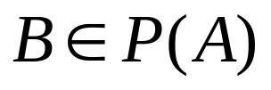

This effectively means
CRISPLY
P(A) = Power set of A
Eg: Suppose
A = {0,1,0,1,0,1,…………….,0,1} – 10⁴ elements
B = {0,0,0,1,0,1,……………….,0,1} – 10⁴ elements
Isn’t with a degree? (only differs in the 2nd element)

Slide 17
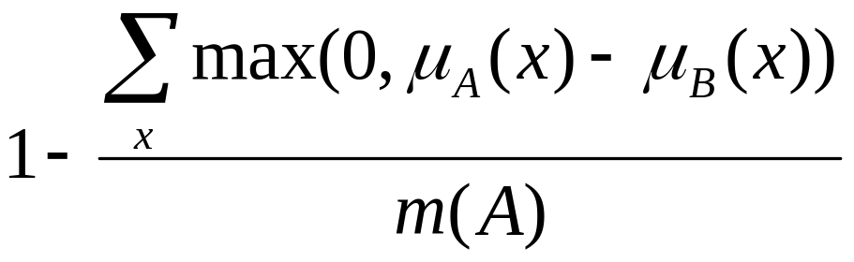
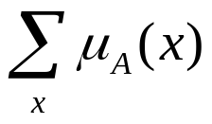
Fuzzy definition of subset
Measured in terms of “fit violation”, i.e. violating the condition
Degree of subset hood = 1- degree of superset hood
=
m(A) = cardinality of A
=

Slide 18

Fuzzy sets to fuzzy logic
Forms the foundation of fuzzy rule based system or fuzzy expert system
Expert System
Rules are of the form
If
then
A_{i}
Where C_{i}s are conditions
Eg: C₁=Colour of the eye yellow
C₂= has fever
C₃=high bilurubin
A = hepatitis

Slide 19



In fuzzy logic we have fuzzy predicates
Classical logic
P(x₁,x₂,x₃…..x_{n}) = 0/1
Fuzzy Logic
P(x₁,x₂,x₃…..x_{n}) = [0,1]
Fuzzy OR
Fuzzy AND
Fuzzy NOT

Slide 20

Fuzzy Implication
Many theories have been advanced and many expressions exist
The most used is Lukasiewitz formula
t(P) = truth value of a proposition/predicate. In fuzzy logic t(P) = [0,1]
t( ) = min[1,1 -t(P)+t(Q)]
Lukasiewitz definition of implication

Slide 21
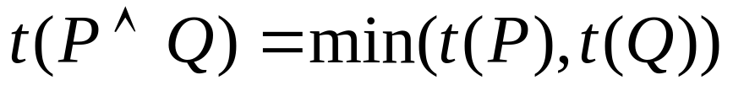
Eg: If pressure is high then Volume is low
High Pressure
Pressure

